Slide 1
HENRI FAYOL
Henri Fayol (1841-1925) is generally hailed as
the founder of the classical management school
–not because he was the first to investigate
managerial behavior but because he was the
first to systematize it.

Slide 2
HENRI FAYOL
1. DIVISION OF LABOR
2. AUTHORITY and RESPONSIBILITY
3. DISCIPLINE MEMBERS IN AN ORGANIZATION
4. UNITY OF COMMAND
5. CENTRALIZATION & DECENTRALIZATION
6. UNITY OF DIRECTION
7. SUBORDINATION OF INDIVIDUAL INTEREST TO ORGANIZATIONAL INTEREST
8. SCALAR CHAIN / THE HIERARCHY

Slide 3
HENRI FAYOL
9. REMUNERATION
10. ORDER
11. INITIATIVE
11. STABILTY OF STAFF
12. EQUITY
14. ESPRIT DE CROPS

Slide 4
HENRI FAYOL
1. DIVISION OF LABOR
the whole work should be divided into different parts and each individual should be assigned only one part of the work according to his ability and taste rather than giving the whole work to one person.
benefits of specialization will become available.
Examle – a chair manufacturer gets an order for manufacturing 100 chairs. He has five workers who will do the job. There are two ways to complete this order. First, every worker should be asked to complete 20 chairs.

Slide 5
The second method can be distributing different parts of the chairs - legs, top , center support, assembling and polishing-to all the five workers in a manner that only one worker does the same job for all the 100 lecture stands. Here, Fayol’s indication is to the second way to do this job and not the former one.
Positive Effect advantages of specialisation are obtained, such as increase in the quality of work, increase in the speed of production, decrease in the wastage of resources.

Slide 6
HENRI FAYOL
2. AUTHORITY and RESPONSIBILITY
authority and responsibility should go hand in hand. when a particular individual is given a particular work and he is made responsible for the results, this can be possible only when he is given sufficient authority to discharge his responsibility.
It is not proper to make a person responsible for any work in the absence of authority

Slide 7
Example- if the CEO of a company has doubled the sales target of the sales manager for the coming year. To achieve this target, authority for appointing necessary sales representatives, advertising according to the need, etc. shall have to be allowed. In case these things are not allowed the sales manager cannot be held responsible for not
Authority without responsibility results in …….
Responsible without authority results in ……..

Slide 8
HENRI FAYOL
3. DISCIPLINE MEMBERS IN AN ORGANIZATION
obedience, need to respect the rules and agreement that govern the organization
Discipline can be established by providing good supervision at all levels, clearly explaining the rules, and implementing a system of reward and punishment. A manager can present a good example to his subordinates by disciplining himself.
Discipline is of 2 forms
a. Self discipline b. Command discipline

Slide 9
HENRI FAYOL
4. UNITY OF COMMANDS
Each employee must receive instruction from one person, Fayol believe that if employee reported.
If there are many superiors giving orders to the same employee, he will not be able to decide as to which order is to be given priority. He thus finds himself in a confused situation, misunderstanding, & conflicts

Slide 10
every superior would like his orders to be given priority. This ego problem creates a possibility of clash. Consequently, their own efficiency is likely to be affected.

Slide 11

HENRI FAYOL
5. UNITY OF DIRECTION
Those operation with in the same organization that have the same objective should be directed by only one manager using one plan.
For example the personnel department in the company should not have a two directors each with a different hiring policy.
unity of direction means that there should be only one manager exercising control over all the activities having the same objective.

Slide 12
HENRI FAYOL
6. SUBORDINATE OF INDIVIDUAL INTEREST TO COMMON GOOD
In any undertaking the interest of employees should not take the precedence over the interest of organization as a whole
For example, a purchase manager of a company has to purchase 100 tonnes of raw material. His relative happens to be a supplier along with other suppliers in the market. The manager purchases the raw material from the firm of his relative at a rate higher than the market rate. This will profit the manager personally, but the company will incur heavy loss. This situation is undesirable.

Slide 13

HENRI FAYOL
7. REMUNERATION TO EMPLOYEES
It is the duty of the manager to ensure that employees are being paid remuneration according to their work. If, however, they are not paid properly for their work, they will not do their work with perfect dedication, honesty and capacity.

Slide 14
For example, If the company is getting good profits. In such a situation, the remuneration of the employees should be increased even without their asking. If this is not done, the employees will leave the company at the first opportunity. Expenses shall have to be incurred on new recruitment which shall bring loss to the company.

Slide 15
HENRI FAYOL
8. CENTRALIZATION & DECENTRALIZATION
– Decreasing the role of subordinates in decision making is centralization, increasing their role is decentralization.
superiors should keep the authority of taking important decisions in their own hands, while the authority to take daily decisions and decisions of less importance should be delegated to the subordinates.
it is advantageous to have more centralisation in a small business unit and more decentralisation in a big business unit.

Slide 17
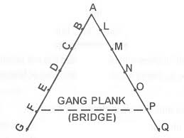
HENRI FAYOL
9. SCALAR CHAIN / THE HIERARCHY
The line of authority in an organization should represent in the neat box and the line of chart runs in order of rank from top management and lowest levels of enterprise.

Slide 18

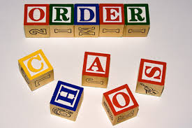
HENRI FAYOL
10. ORDER
Materials should be in the right place at the right time. People in particular should be in job or position they are most suited to.

Slide 19

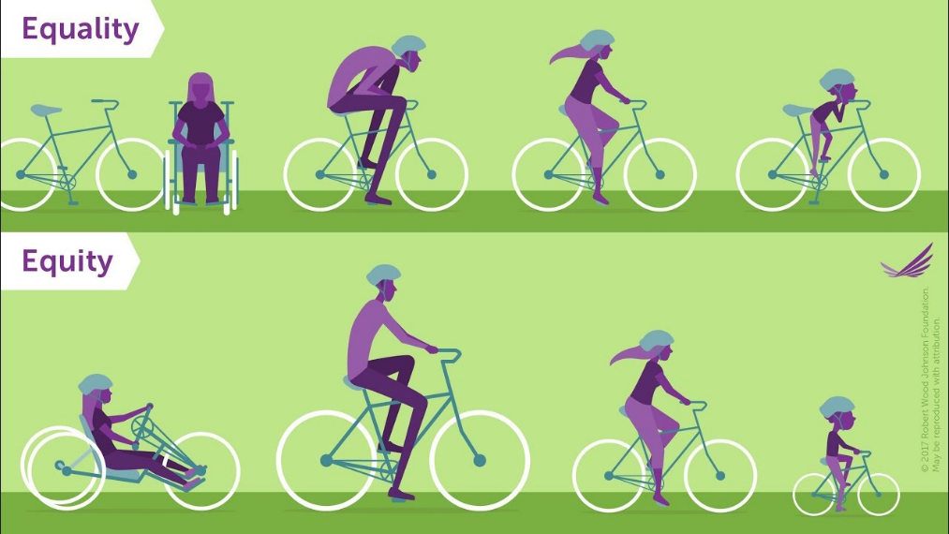
HENRI FAYOL
11. EQUITY
Managers should be fair and friendly to their subordinate. Combination of justice and kindness, also brings loyalty to the firm

Slide 20
HENRI FAYOL
12. STABILTY OF STAFF
A high employee turnover rate reduces
the efficient functioning of an organization.
High rate of labor turnover will result in increased expenses because of selecting them time and again, and giving them training afresh.
it also lowers the prestige of the organization and creates a feeling of insecurity among the employees which keeps them busy in finding out new avenues of work. the sense of dedication cannot be created among them.

Slide 21

it is true that if the workers in a company are not treated well and the atmosphere in the company is also unhealthy, the employees will not stay for a long time. In other words, they will leave the company at the first opportunity available. This situation is absolutely harmful.

Slide 22
HENRI FAYOL
13. INITIATIVE & CREATIVITY
Subordinate should be given the freedom to conceive and carry out their plans even though some mistake may result.

Slide 23
For example, a salesman suggests to his sales manager to implement a new advertisement technique. The sales manager sends him away by telling him that it is not possible and ignores the suggestion altogether.
In such a situation the salesman who is depressed, will never venture to offer any suggestion in future because his desire of taking initiative has been suppressed.

Slide 24
On the contrary, if his suggestion had been listened to carefully (even though not to be implemented) he could have taken the courage to offer some suggestion in future. Such an action would simply have encouraged his initiative.

Slide 25
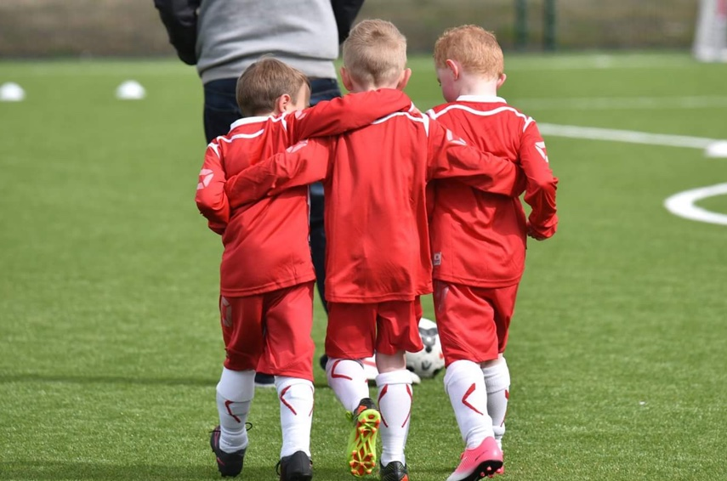
HENRI FAYOL
14. ESPRIT DE CROPS / union is strength
– Promoting team spirit will give the organization a sense of unity.
– To Fayol even the small factor help to develop the spirit.
– employee should be aware
that team contribution is
is always better

Slide 26
THANK YOU

